Slide 1
Task Offloading Based on LSTM Prediction and Deep Reinforcement Learning for Efficient Edge Computing in IoT
Task offloading in Edge-Cloud
with LSTM for prediction of next task and
DDQN for task-offloading
Youpeng Tu , Haiming Chen , Linjie Yan and Xinyan Zhou

Slide 2
Overview
A joint decision-making problem for cost minimization in IoT edge computing is modeled, taking into account processing latency, energy consumption, and task throw rate.
The Online Predictive Offloading (OPO) algorithm is proposed based on Deep Reinforcement Learning and Long Short-Term Memory.
The algorithm predicts the edge server's load in real-time and allocates resources in advance, improving the convergence accuracy and speed of the offloading process.
The algorithm reduces the average latency by 6.25%, offloading cost by 25.6%, and task throw rate by 31.7%.

Slide 3
Introduction
Edge computing emerged to meet the demand of IoT devices that traditional cloud computing cannot handle.
Edge computing involves placing small servers at the edge of the network closer to user devices.
Core of edge computing is computation offloading, which reduces the computational workload and energy consumption of devices.
Offloading problem consists of deciding whether to offload and to which edge server.
Challenges include transmission delays and energy consumption, load imbalance, and unreasonable offloading decisions.
Current research on offloading decision problem includes traditional algorithms and reinforcement learning algorithms, but they don't take into account the dynamic and predictable nature of the task.
This paper proposes the Online Predictive Offloading (OPO) algorithm that combines LSTM and DRL to make real-time predictions of task information and offloading decisions.
OPO aims to minimize task dropped rate, computational cost, and response delay while avoiding network congestion and server overloading.

Slide 4
Contributions
Modeling the problem of computing offloading in a multi-edge, multi-device computing scenario as a nonlinear optimization problem. Moreover, the goal of task offloading is minimizing long-term costs in terms of latency and energy consumption.
By predicting the characteristics of tasks and edge server loads, tasks are dynamically offloaded to the optimal edge server. In the decision model, the prediction is combined with task decision to dynamically allocate resources for different tasks to further reduce latency and improve service quality.
The proposed model and method are extensively evaluated with real-world datasets. The results reveal that the model developed in this paper can effectively reduce the cost using the DRL algorithm with Deep Q Network (DQN) and its variants. The OPO algorithm can maintain low task latency and task discard rate when facing large and complex scenarios

Slide 5
Literature Survey
. Offloading Methods with Different Problem Solving Strategies
The traditional IoT suffered from scalability and elasticity issues, which recent advances in DRL algorithms aim to address.
Researchers are combining neural networks and reinforcement learning for task offloading problems in unknown dynamic IoT environments.
Huang et al. proposed a distributed deep learning algorithm for optimal solutions without manual labeling of data.
Tang et al. formulated a task offloading problem with reinforcement learning for device decision-making without knowing other device's decisions.
Chen et al. considered communication in ultradense LAN and used DQN algorithm for optimal policy based on unknown network dynamic environment.
Song et al. aimed to optimize resource utilization, energy consumption, and network latency by predicting user behavior with a variant of the DQN algorithm.
Zou et al. used improved Actor-Critic algorithm to balance workload between edge server and final task.
13.Chen et al. improved policy search efficiency by spreading high-dimensional decision space using Monte Carlo Tree Search and Deep Neural Network algorithms.

Slide 6
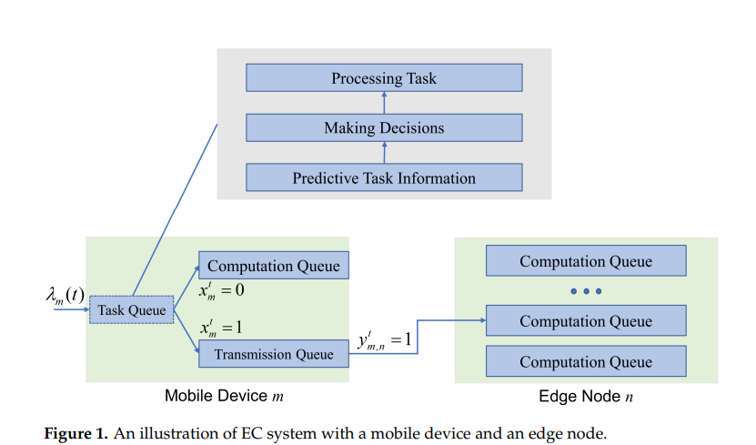
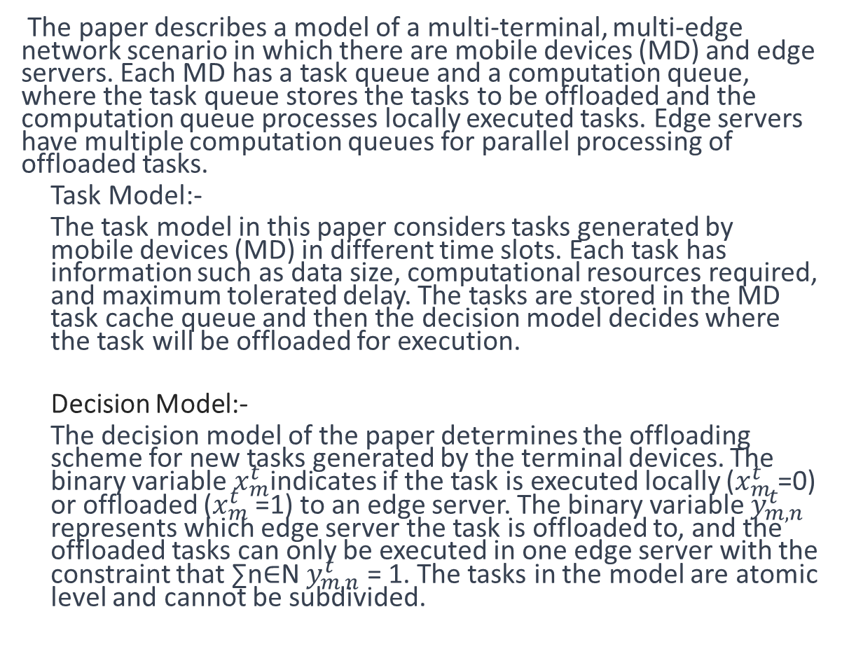
System Model
The paper describes a model of a multi-terminal, multi-edge network scenario in which there are mobile devices (MD) and edge servers. Each MD has a task queue and a computation queue, where the task queue stores the tasks to be offloaded and the computation queue processes locally executed tasks. Edge servers have multiple computation queues for parallel processing of offloaded tasks.
Task Model:-
The task model in this paper considers tasks generated by mobile devices (MD) in different time slots. Each task has information such as data size, computational resources required, and maximum tolerated delay. The tasks are stored in the MD task cache queue and then the decision model decides where the task will be offloaded for execution.
Decision Model:-
The decision model of the paper determines the offloading scheme for new tasks generated by the terminal devices. The binary variable $x_{m}^{t}$indicates if the task is executed locally ($x_{m}^{t}$=0) or offloaded ($x_{m}^{t}$=1) to an edge server. The binary variable $y_{m,n}^{t}$ represents which edge server the task is offloaded to, and the offloaded tasks can only be executed in one edge server with the constraint that ∑n∈N$y_{m,n}^{t}$ = 1. The tasks in the model are atomic level and cannot be subdivided.

Slide 7
Computational Model
1. Terminal Layer Computing Model
The model includes two queues: task queue and task computation queue. The energy consumption of the MD to execute the task locally is calculated by summing the computation and waiting energy consumption, expressed as the product of power and time.
2.Edge Layer Computing Model :
The Edge Layer Computing Model calculates the processing latency and total delay for tasks offloaded from mobile devices (MDs) to edge servers. The processing latency is calculated as the product of the task size and the current processing capacity of the edge node. The total delay is the minimum of the waiting delay in the local model, transmission delay, and processing latency, or the maximum tolerated delay. The energy consumption of tasks offloaded to the edge server is calculated as the sum of waiting energy consumption, transmission consumption, and edge node computation consumption.
The communication model in the paper presents a trade-off between the time delay and energy consumption of a task for its computation. The goal is to minimize the total cost of tasks over time. The model has constraints on task processing and transmission, including only allowing one computing node, maximum processing delay and capacity, maximum transmission power and bandwidth.

Slide 8
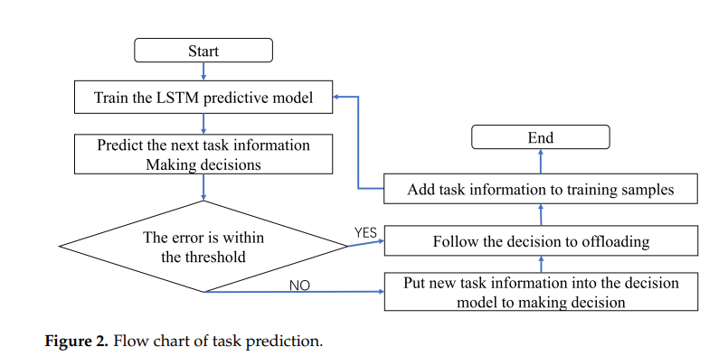
Prediction Model: Task Prediction Model
1. Task Prediction Model:-
A prediction model is used in computational offloading systems to predict future tasks based on the history of user devices. The prediction is made using a trained LSTM model, taking the input of the previous task data and predicting the next time slot task data. The goal of the prediction model is to improve the accuracy of task data prediction as much as possible. The real task is compared with the predicted task and if the error is within the allowed threshold, the task is directly offloaded. If not, the offloading decision is made using the decision model, and the information of the new task is added to the historical data for training the LSTM model.

Slide 9
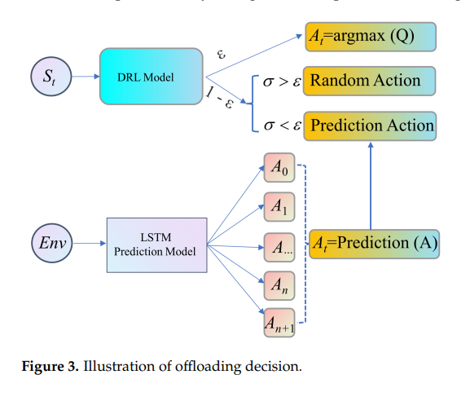
Prediction Model: Load Prediction Model
A load prediction model is used to predict the future server load in an edge computing system to avoid load imbalance. The model uses an LSTM algorithm to predict the number of idle queues on edge nodes based on historical data of CPU occupancy, network usage, and current task execution. The predicted idle server is preferentially selected for offloading during DRL training. The DRL agent selects actions through a probability, with the largest Q value selected with ε probability and random action selected with 1-ε probability. The use of a predicted idle server as a pre-selected action in the Prediction Action reduces the number of explorations and improves the convergence speed of the algorithm.

Slide 10
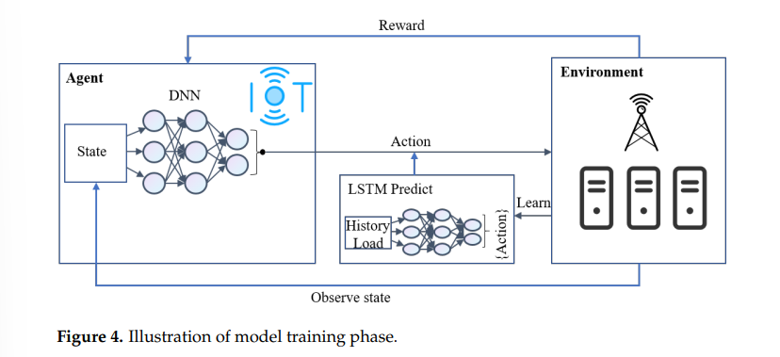
Overall Framework
The DRL model combines a prediction model with the deep reinforcement learning model.
The model training phase uses LSTM to predict the load of the edge server to make optimal offloading decisions and avoid load imbalance.
The offloading decision phase uses LSTM to predict the features of the next arriving task and gives it to the reinforcement learning decision model to make the offloading scheme.
The offloading decision is based on predicted task information, but if there is a large error between real and predicted task, the decision is made based on the real task.
The prediction helps reduce the response and waiting delay of tasks in the system.

Slide 11
Algorithm Design
The DQN algorithm consists of an agent, state, action, and reward. The policy generated is a mapping of states to actions to obtain a reward R. The traditional Q-learning algorithm cannot handle large state and action spaces, but DQN solves this problem by using deep neural networks to fit the optimal Q-functions, instead of storing state-action pairs in a Q-table. DQN also uses the experience replay method to break the correlation within the data and reduce overfitting. Double DQN is also used to eliminate the overestimation problem by using two networks, QA and QB, to separate the steps of selecting the action and evaluating the Q value.
The decision model in edge computing consists of the following elements:
Agent: each mobile device (MD) acts as an agent or scheduler that chooses the next action based on the current state of the environment. The goal is to minimize the total cost and make optimal decisions.
State: the state of the environment includes task properties, waiting and transmission queue state, bandwidth, and edge node load.
Action: based on the state, the agent decides whether to offload a task, which server to offload to, and the transmission power.
Reward: the agent receives a reward after taking an action and the goal is to maximize the long-term discounted reward through continuous interaction with the environment by mapping states to actions optimally.
The reward function in the decision model is designed to minimize the total cost of processing delay and energy consumption. It considers the completion time and energy consumption of tasks, and rewards tasks that complete within the specified time limit and with least energy consumption. The DRL algorithm is a combination of DQN, improved Double DQN, and improved Dueling DQN algorithms with LSTM prediction. The proposed Online Predictive Offloading (OPO) algorithm solves the task offloading problem with deep reinforcement learning. The algorithm includes a random action selection with probability 1−ε or a predicted action by LSTM, and network parameter updates using the Double DQN method.

Slide 12
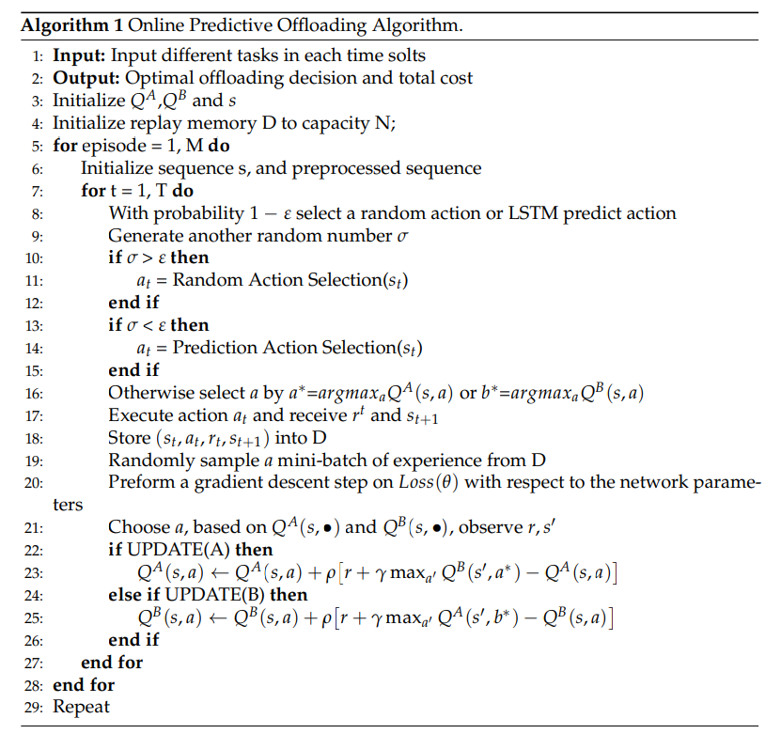
Algorithm
The Online Predictive Offloading (OPO) algorithm is a deep reinforcement learning algorithm designed to solve the problem of task offloading in a system. The algorithm takes as input different tasks and outputs the optimal offloading decision and total cost. It uses QA, QB, and s as initial inputs and a replay memory D with a capacity of N. The algorithm trains the model by executing actions and receiving rewards, storing the experience in the replay memory, and updating the network parameters through a gradient descent step. The algorithm uses a combination of random action selection and LSTM-predicted action selection with a probability of 1-ε, and the QA and QB values are updated based on the Double DQN update method. The algorithm repeats until the desired number of episodes is reached.

Slide 13
Experimental Results
The authors evaluated their proposed offloading policy optimization (OPO) algorithm for edge computing using real-world data from Google Cluster.
The data was preprocessed for compatibility with the established model, and a history window of 50 was used for task prediction experiment.
The results showed that LSTM & DRL performed better than DRL after certain training.
The OPO algorithm outperformed other algorithms such as DQN, Double DQN, and Dueling DQN in terms of average delay, energy consumption, and task throw volume.
The study showed that the OPO algorithm improved average latency, offloading cost, and reduced task drop rate as the number of tasks increased.
The learning rate of 0.001 resulted in fast convergence rate with low convergence cost.

Slide 14
Summary
The paper studies the computational offloading problem in edge computing
The optimization objective is to minimize long-term cost by considering task latency, energy consumption, and discard rate
The model is solved using LSTM networks for prediction and DQN for decision-making
The proposed OPO algorithm is a deep reinforcement learning-based approach combining Double DQN and Dueling DQN to improve accuracy and stability
LSTM is used to improve the training speed and accuracy of the DRL model
The OPO algorithm provides a better offloading decision solution for real IoT environments
The results are based on simulation and future research will consider migration to experiments and improvement with latest algorithms and techniques.

Slide 15
Literature Survey
. Offloading Methods with Different Modeling Objects
Computing offloading decisions are categorized into minimizing delay, minimizing energy consumption, and minimizing system cost.
Offloading strategies aim to improve Quality of Service (QoS) and enhance the computing power of terminal devices.
Lightweight and effective offloading scheme is proposed by Shu et al. to minimize execution time.
Guo et al. designed offloading strategies to minimize task execution delays and save energy through data caching.
Ali et al. proposed a federated RL-based channel resource allocation framework for 5G networks.
Zhao et al. proposed a local computing offloading method to minimize total energy consumption.
Vu et al. proposed an edge computing network to minimize energy consumption and satisfy latency requirements.
Yuan et al. proposed a cloud-edge computing system with a profit-maximizing algorithm to minimize system cost and satisfy task response time.
Alqerm et al. developed a framework named DeepEdge to allocate resources to IoT applications and maximize user's Quality of Experience (QoE).

